Slide 1


Asymmetric Encryption Algorithms

Slide 2
Diffie-Hellman Key Exchange
Method of securely exchanging cryptographic keys over a public channel
Published in 1976
Named after Witfield Diffie and Martin Hellman
Patented 1977 by Diffie, Hellman and Ralph Merkle
US Patent #4200770, now expired
Diffie-Helman is a method or process
Does not itself encrypt or authenticate
Perfect Forward Secrecy provided by
Ephemeral Diffie-Hellman (EDH or DHE)
When used with elliptic curve cryptography, you get ECDHE

Slide 3



Diffie-Hellman Key Exchange
Use asymmetric cryptography to create a symmetric key
Symmetric Key
Person A
Person A
Private Key
Person B
Public Key
Symmetric Key
Person B
Person B
Private Key
Person A
Public Key

Slide 4

RSA
Named for creators Ron Rivest, Adi Shamir, and Leonard Adelman
Published the RSA cipher in 1977
(Recall that Diffie-Hellman was released in 1976!)
First practical system using public-key cryptography
Encrypts, decrypts, provides digital signatures
Based on two very large prime numbers
If you don’t have the factors, it’s hard to find them in timely way
Now public domain
Used for web encryption and digital rights management (DRM)

Slide 5

Digital Signature Algorithm (DSA)
Standard for digital signatures
Modifies Diffie-Hellman for use in digital signatures
Federal Information Processing Standard for digital signatures
FIPS 186-4
Since 1993
Combine with elliptic curve cryptography
Fast and efficient digital signatures
ECDSA – Elliptic Curve Digital Signature Algorithm

Slide 6
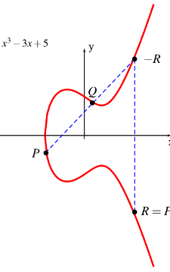
Elliptic Curve Cryptography (ECC)
Used for encryption, digital signatures, etc.
Assymmetric encryption
Uses large integers composed of two or more large prime numbers
Uses curves instead
Just as hard to find unknown logarithm of some elliptic curve from a publicly known starting point
Uses small keys
Relatively simple geometry – fast to compute
Yields Elliptic Curve Digital Signature Algorithm (ECDSA)

Slide 7
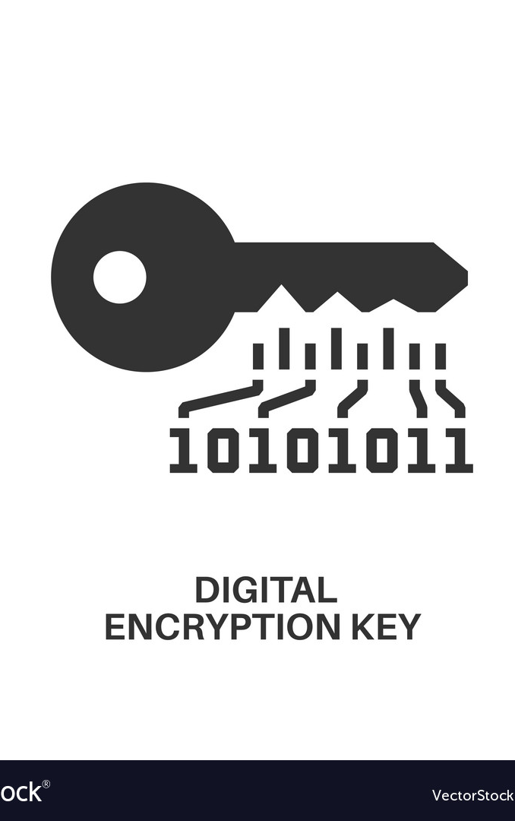
Pretty Good Privacy (PGP) and GPG
Popular asymmetric encryption
Created by Phil Zimmerman, 1991
“Why I Wrote PGP”
https://www.philzimmermann.com/EN/essays/WhyIWrotePGP.html
Owned by Symantec
Open standard
OpenPGP (RFC 4880)
GNU Privacy Guard (GPG)
Compatible with Symantec’s PGP

